Slide 1




AUTOMATED FOREX PRICE ANALYSIS AND TRADE EXECUTION WITH AI
Presented by:
Supervised by:
Ojo-Bello Oluwayimika Michael (10758282)
Dr. Percy Okae
Nutsugah Abel Mawuko (10813963)

Slide 2

CONTENT
01
INTRODUCTION
06
ENGINEERING SOLUTION
02
PROBLEM STATEMENT
07
RESOURCE REQUIREMENT AND COST
03
SIGNIFICANCE OF PROJECT
08
DESIGN IMPLEMENTATION, TESTING AND RESULT
04
OBJECTIVES AND SCOPE
09
CONCLUSION
05
LITERATURE REVIEW
10
REFERENCES

Slide 3
INTRODUCTION
The foreign exchange (Forex or FX) market is the largest and most liquid financial market in the world. Predicting the market with complete accuracy is impossible due to its volatility.
Advances in machine learning, natural language processing, and computer hardware enable the processing of large amounts of multimodal data. These advancements allow for market analysis with a higher accuracy than would be impossible for a human to perform.
This can increase the accessibility of forex trading for individuals, allowing them to participate profitably without being part of large financial institutions. This could boost the economy by contributing to GDP growth.

Slide 4



SIGNIFICANCE OF WORK
Enhanced Trading Efficiency: Automated, 24/7 trading with high speed and precision.
Data-Driven Decision Making: Utilizes advanced analytics and pattern recognition.
Risk Management: Ensures consistent strategy implementation with built-in risk controls.
Scalability: Operates across multiple markets and handles high transaction volumes.
Cost Efficiency: Reduces operational costs and optimizes resource use.
Adaptability and Learning: Continuously improves through machine learning and backtesting.
Market Impact: Increases market liquidity and drives financial technology advancements.

Slide 5

OBJECTIVE AND SCOPE
Develop a model to enhance prediction accuracy for the EUR/USD currency pair.
Implement a trading strategy based on model predictions.
Manage risk effectively to maximize trading profits.
Create a trading bot that automates trade execution based on the developed strategy.

Slide 6
LITERATURE REVIEW
AUTHOR | PURPOSE | RESULTS | LIMITATIONS
David Makiya et al (2022) | Prediction of the kenyan forex market using DDM(Data Driven Model) | Success in predicting the kenyan forex market | DDM’s may have reduced capacity to extrapolate beyond the data they were trained on and can be prone to overfitting. No accountability for external factors that can contribute to the forex market
Dias Tiago et al.(2021) | Prediction of the EUR/USD market using the LSTM model | Inaccurate prediction of unseen forex data. | No accountability for social and economic factors. The technical indicator used was insufficient to accurately predict the data.
Asmaa M. Moustafa et al (2023) | Forex Price Prediction Using Deep Neural Network and FNF. explore how FNF can affect accuracy. | Improved accuracy when using the generated normalization function. | The normalization function didn’t improve the LSTM model accuracy, so it wont be applicable for this study. The model also wasn’t tested on larger long term datasets which could have impacted results.
Deniz Can Yıldırım et al (2023) | Forecasting directional movement of Forex data using LSTM with technical and macroeconomic indicators | Hybrid combination of technical indicators and macroeconomic indicators proved to increase accuracy of the price predictions. | The model was able to predict accurately the forex market but was not validated by applying trading strategies to review the profitability.

Slide 7

PROPOSED SOLUTION
Model Selection: Utilize an LSTM model trained with a hybrid of technical indicators and sentiment analysis.
Technical Indicators: Include RSI, SMA_20, ROC, MACD, and CCI to capture various market trends and conditions.
Sentiment Analysis: Incorporate news data on the EUR/USD pair to account for the impact of social, political, and economic factors on market prices.
Trading Strategy Development: Create a trading strategy with buy, hold, and sell signals based on the model’s predictions to maximize profit.
CUSTOMERS

Slide 8
PROPOSED SOLUTION
Develop a Trading Bot(Expert Advisor) that connects with a trading platform and makes trades autonomously
Risk Management: Implement risk management techniques to protect capital and enhance trading performance.
CUSTOMERS

Slide 9

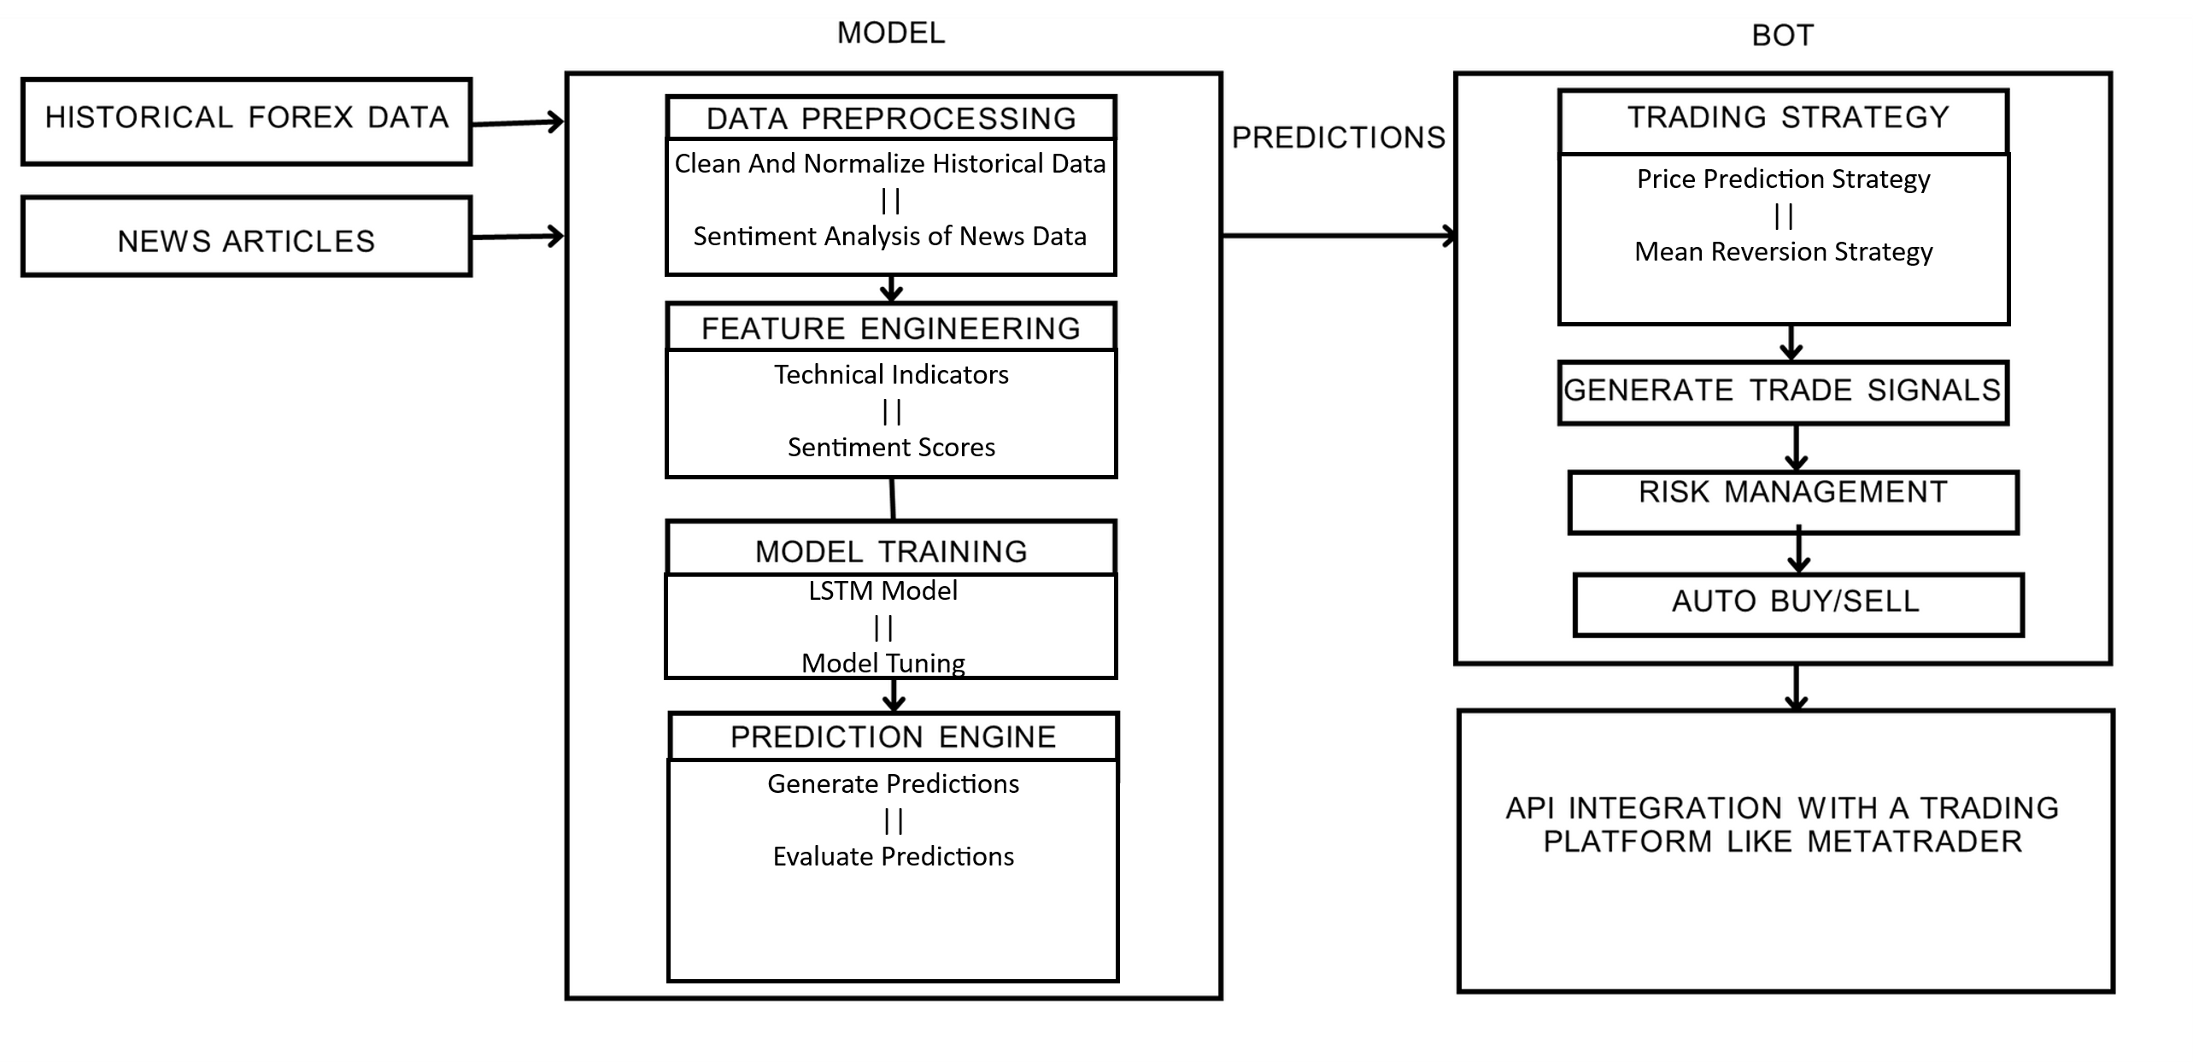
SYSTEM ARCHITECTURE

Slide 10
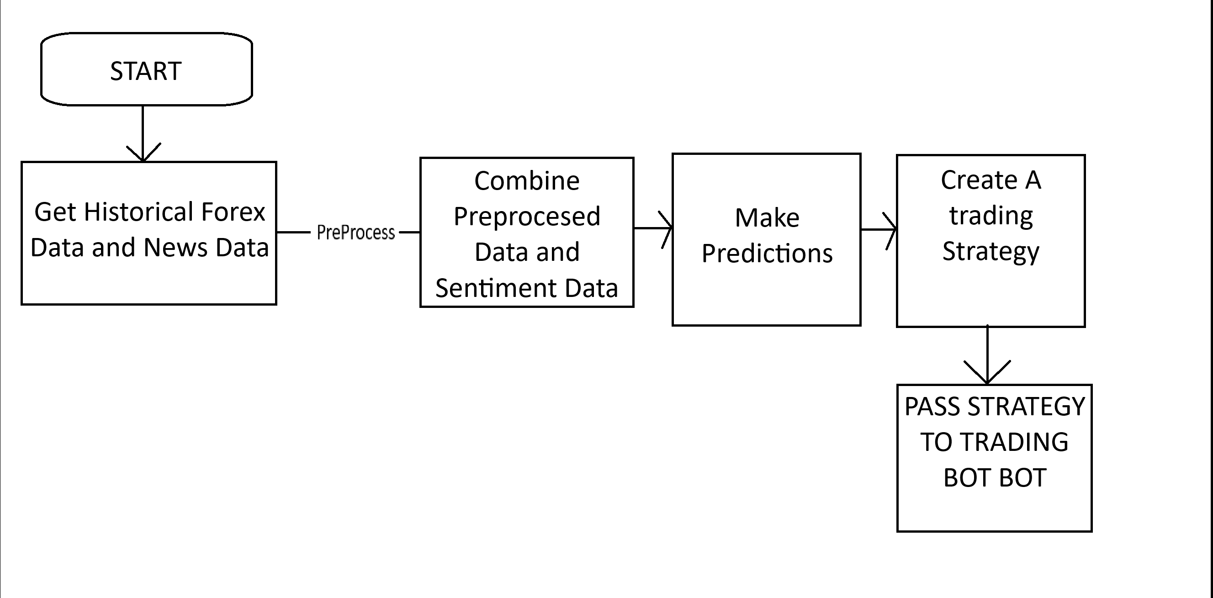
WORKFLOW DIAGRAM(Model)

Slide 11
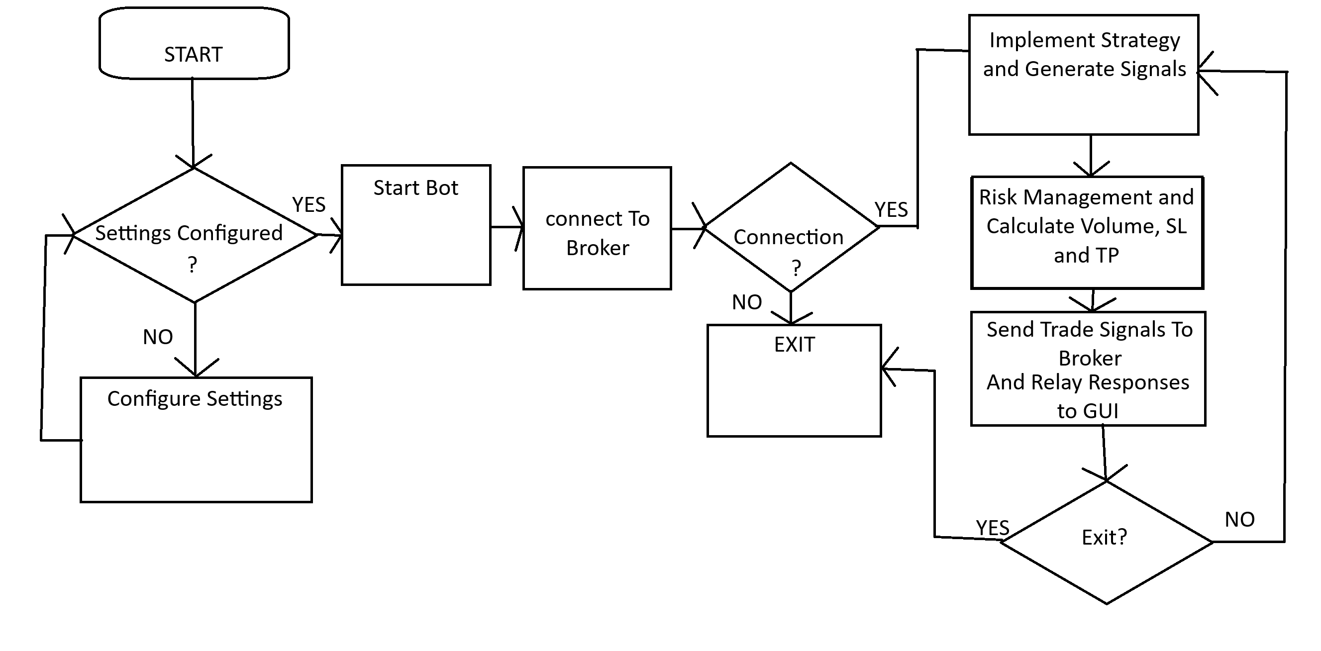
WORKFLOW DIAGRAM(BOT)

Slide 12
DESIGN PROCEDURE
Develop a model to enhance prediction accuracy for the EUR/USD currency pair.
Implement a trading strategy based on model predictions.
Manage risk effectively to maximize trading profits.
Create a trading bot that automates trade execution based on the developed strategy.

Slide 13
MODEL IMPLEMENTATION
Data Cleaning
Handle Missing Data: Remove NaN values.
Data Type Conversion: Convert data to appropriate formats.
Preprocessing Function: Automate cleaning tasks.
Feature Engineering
Technical Indicators: Generate EMA, MACD, RSI
Sentiment Analysis: Calculate sentiment scores from news headlines/articles.
Model Training
Data Preparation: Select features and split into training, validation, and test sets.
Scaling and Standardization: Apply MinMax scaling and standardize features.

Slide 14
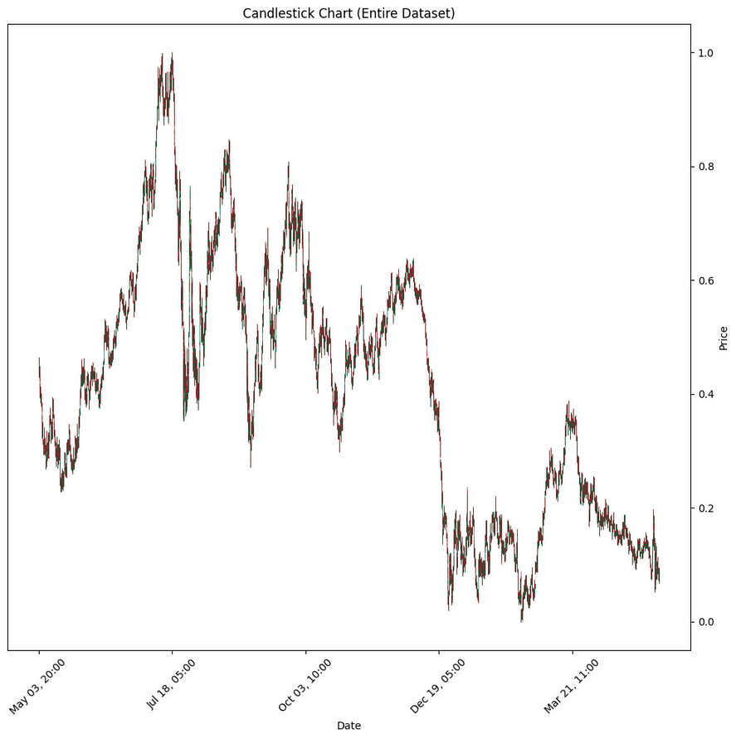
MODEL IMPLEMENTATION
Model Performance on unseen data(93% accuracy on unseen data)
Actual
Predicted

Slide 15
DEVELOPMENT OF TRADING STRATEGY
Based on our models predictions we found using EMA Crossover, MACD Crossover and RSI gave us the most profit after backtesting(profit of 43.1%)
Achieved profits of 43.1% after a years worth of backtesting showing that the strategy was a profitable one.
Thousands of trades implemented over a year but this wont be noticeable as it is would all be autonomously done by the bot

Slide 16
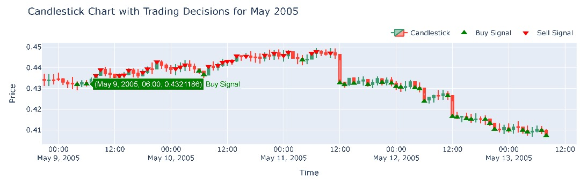
FINAL CANDLE STICKS CHART

Slide 17
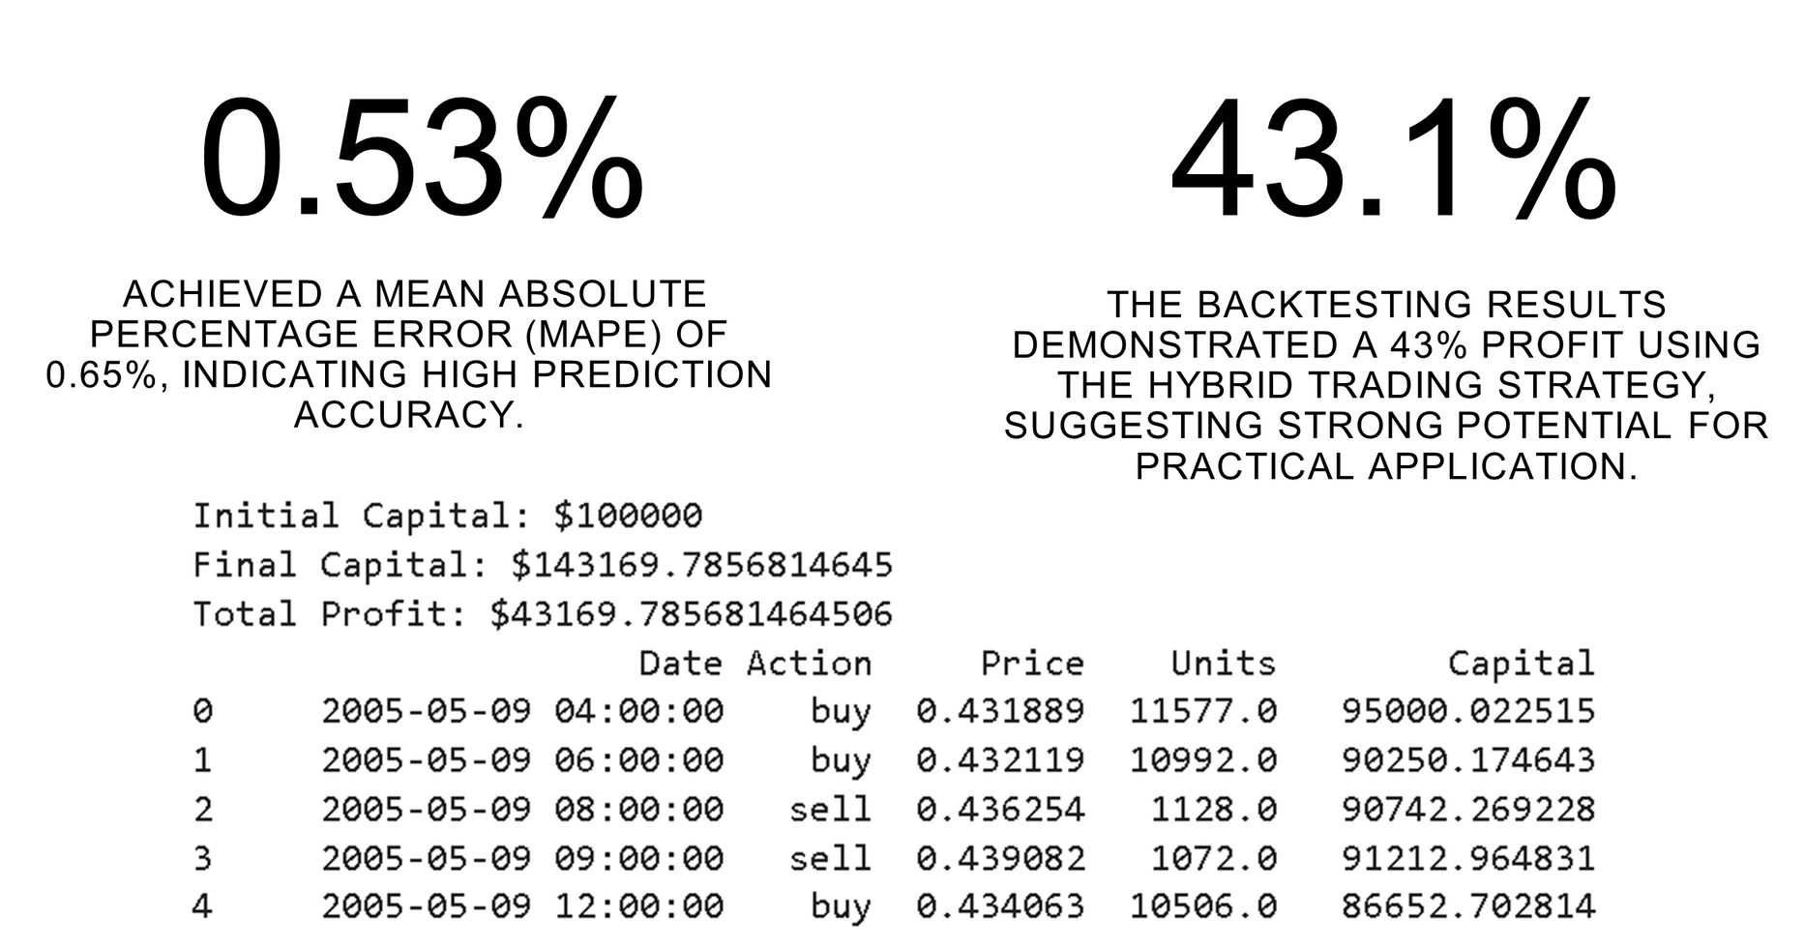
BACKTESTING RESULTS
0.65

Slide 18
DEVELOPMENT OF BOT
Expert Advisors (EAs) are programs that run on a trading platform, used to monitor and trade financial markets using algorithms.
Using python, due to extensive libraries for integrating with the trading platform and for implementing our indicator calculations(TALIB, METATRADER 5)
Metatrader 5 as the trading platform, due to easy integration with python
IC Markets as the Broker

Slide 19
Libraries Used
TA Lib for applying technical indicators
Tkinter for Graphical User Interface
Metatrader for integrating with Broker(Sending Signals and Retrieving Account Information)
PRAW for getting sentiment from reddit for sentiment analysis
TextBlob for sentiment analysis before replacing with our model
Pandas for handling candlestick data

Slide 20
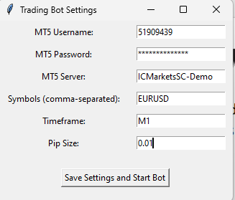
How The Bot Works
The settings are stored in a settings.json file, so when the program starts it checks for the settings.json. If it doesn’t exist it opens a window to configure your program settings

Slide 21
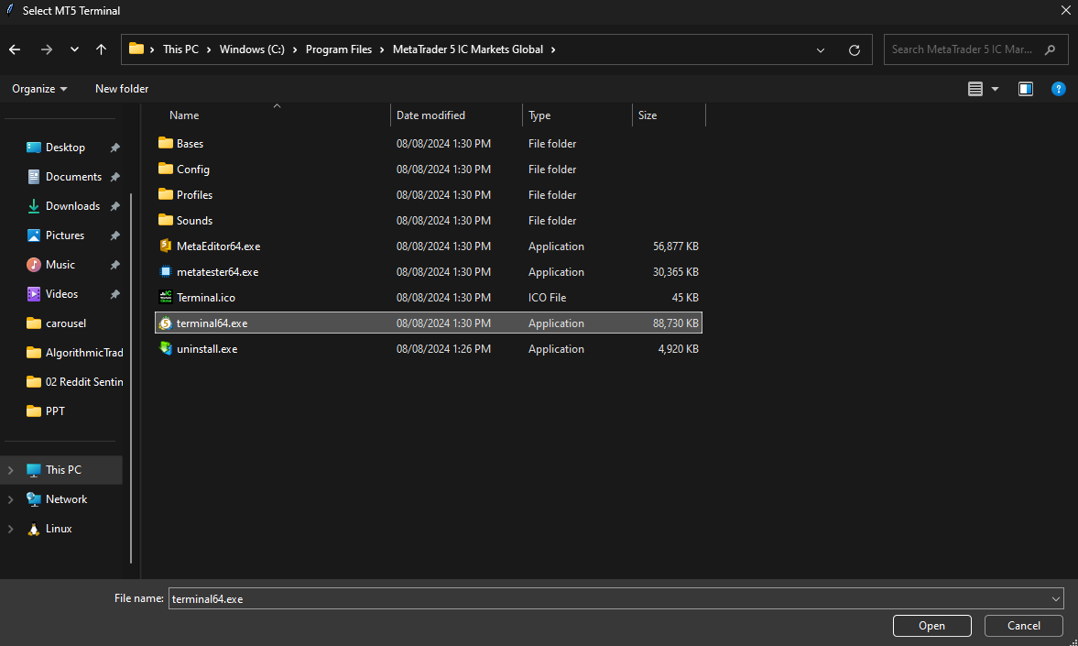
How The Bot Works
Then you browse to select your brokers terminal , as multiple brokers can be installed at the same time

Slide 22
How The Bot Works
Then you browse to select your brokers terminal , as multiple brokers can be installed at the same time

Slide 23
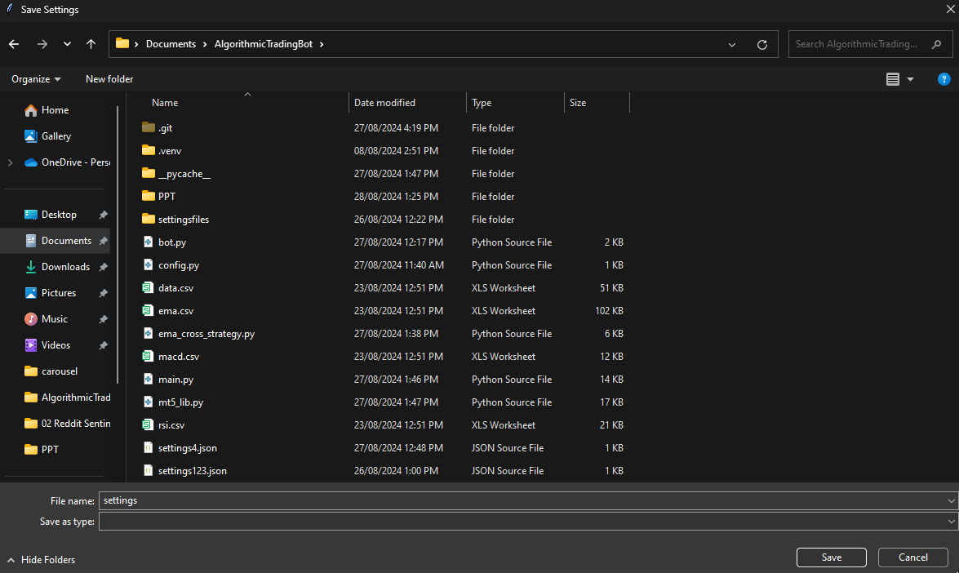
How The Bot Works
next you choose the location to store the settings, which should be in the program install location

Slide 24
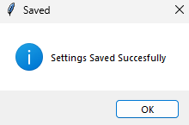
How The Bot Works
Once valid details are entered you should see this

Slide 25
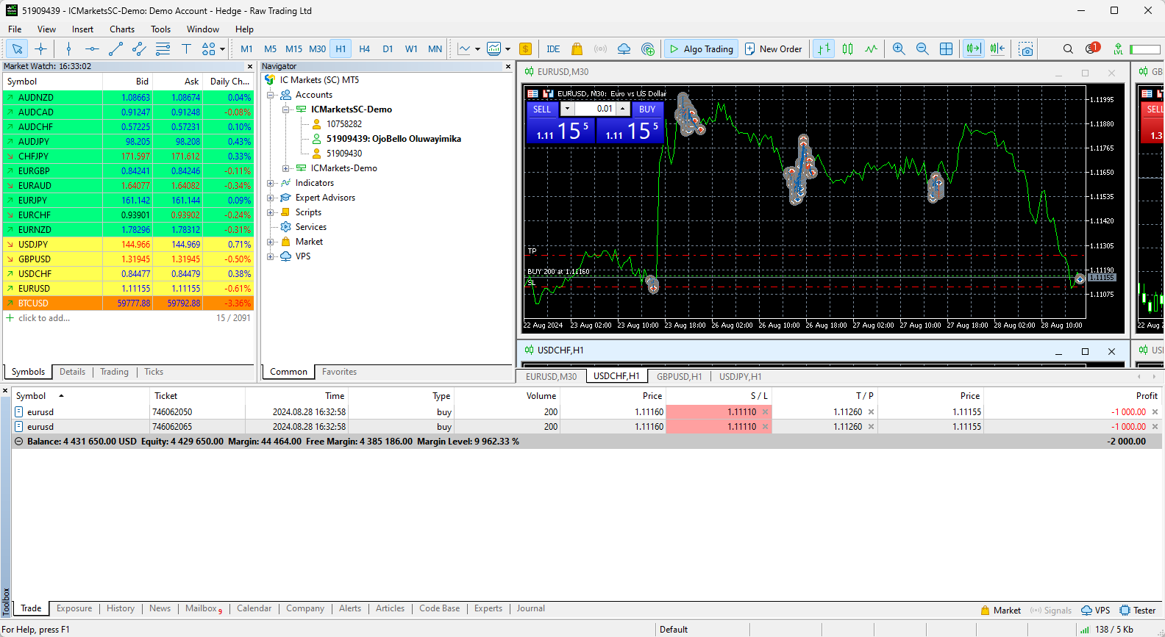
How The Bot Works
After wards your broker opens up automatically logged in with the details in settings

Slide 26
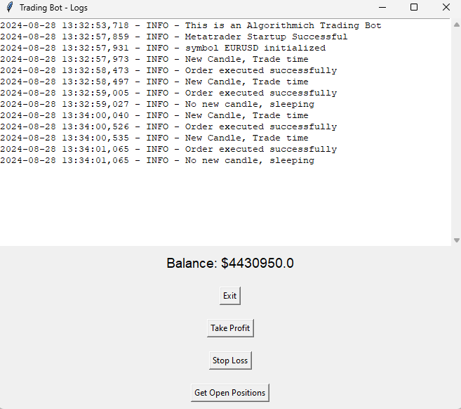
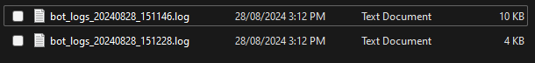
How The Bot Works
The bot also opens allowing you to see what is going on, and buttons to interact with the broker, the logs are saved to a log file, which can be sent later for errors.

Slide 27
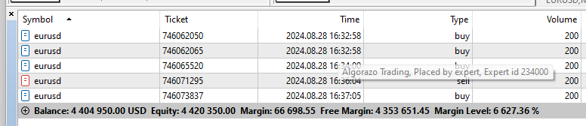
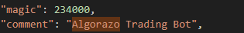
How The Bot Works
The bot also opens allowing you to see what is going on, and buttons to interact with the broker

Slide 28
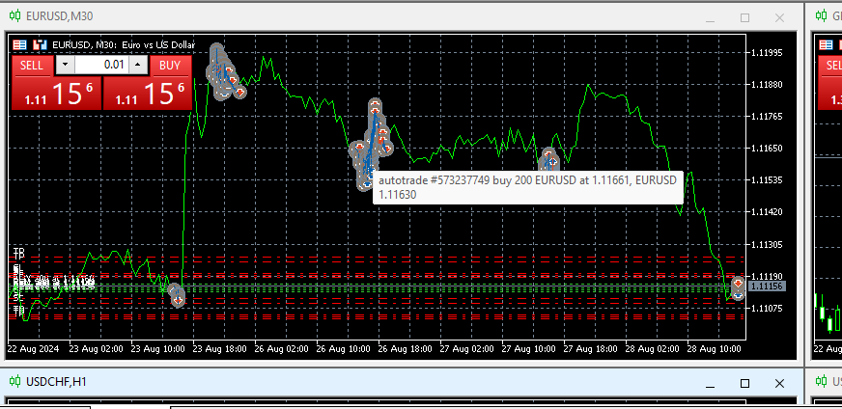
How The Bot Works
From the broker we see that trades are being made automatically

Slide 29
How The Bot Works
Based on the strategy and sentiment analysis gotten from reddits “EURUSD” subreddit the bot keeps making trades until the user exits.
Buttons to view open orders, stop losses or take profits.
View open orders gives generalized view of open orders but more detailed view can be seen on the trading platformm

Slide 30
RESOURCE REQUIREMENTS AND COST
Programming Language: Python 3.10
Stable Internet Connection
IDE/Development Tools:
VSCode (free)

Slide 31
RESOURCE REQUIREMENTS USER
Software Requirements
Operating System: Windows
Programming Language: Python 3.10
IDE/Development Tools:
Jupyter Notebook / JupyterLab (free)
VSCode (free)

Slide 32
RESOURCE REQUIREMENTS USER
Hardware Requirements(Recommended)
Processor: Intel i3/i5 or AMD Ryzen 5/7
Memory (RAM): 8 GB (16 GB recommended)
Storage: 50MB
GPU (Optional)
Network: Stable internet connection

Slide 33
DATA SOURCES
Kaggle
ForexSB (forexsb.com)
MetaTrader

Slide 34
CONCLUSION
Key Findings:
Model Accuracy: Achieved a fairly high prediction accuracy with a MAPE (Mean Absolute Percentage Error) of 0.65%.
Profitability: Backtesting demonstrated a 43% profit using the hybrid trading strategy.
Feature Importance: Technical indicators and sentiment analysis significantly enhanced predictive power.
Automation of Trading: 24/7 trading can be achieved through automation to allow for constant participation in the market and avoid missing market oppurtunities

Slide 35
CONCLUSION
Impact on Forex Trading:
Enhanced decision-making capabilities.
Realized financial benefits through improved trading performance.
Increased automation and operational efficiency.
Enhanced risk management practices.
Strengthened market competitiveness.
Trading Bot to help reduce the skill gap for entering into the forex market which is a very lucrative market that can improve economy by providing income source for participants.

Slide 36
REFERENCES
[1] Makiya, D., & Shibwabo, B. (2022). A model for forex market price prediction using deep learning. 2022 International Conference on Innovation and Intelligence for Informatics, Computing, and Technologies (3ICT). https://doi.org/10.1109/3ICT56508.2022.9990616
[2] Ranjit, S., Shrestha, S., Subedi, S., & Shakya, S. (2018). Foreign rate exchange prediction using neural network and sentiment analysis. 2018 International Conference on Advances in Computing, Communication Control and Networking (ICACCCN). https://doi.org/10.1109/ICACCCN.2018.8748819
[3] Ayitey, M., Junior, Appiahene, P., Appiah, O., & Bombie, C. N. (2023). Forex market forecasting using machine learning: Systematic literature review and meta-analysis. Journal of Big Data, 10(1). https://doi.org/10.1186/s40537-022-00676-2
[4] Moustafa, A. M., Fakhr, M. W., & Maghraby, F. A. (2023). Forex prices prediction using deep neural network and FNF. International Journal of Advanced Computer Science and Applications/International Journal of Advanced Computer Science & Applications, 14(11). https://doi.org/10.14569/IJACSA.2023.0141187
[5] Yildirim, D. C., Toroslu, I. H., & Fiore, U. (2021). Forecasting directional movement of forex data using LSTM with technical and macroeconomic indicators. Financial Innovation, 7(1). https://doi.org/10.1186/s40854- 020-00220-2

Slide 37
THANK YOU

